Slide 1

DriverPass System Analysis
Matthew Muller
Notes:
[No speaker notes required for this slide.]

Slide 2

System Requirements
Functional Requirements:
The system shall coordinate materials and assessments using online learning modality
The system shall track all appointment information and maintain activity reports
Non-Functional Requirements:
The system will distinguish between different users via their case-sensitive username and password
System must be connected to DMV database in order to receive updates with new rules, policies, and practice questions
Notes:
The first functional requirement of the DriverPass system that I included was that the system shall coordinate materials and assessments using online learning modality. This is an essential function of the system’s LMS that allows DriverPass to continuously provide students with access to the content and practice tests that they deem to be the most effective. This requirement ensures that the system meets DriverPass’s need for an online LMS that helps to provide students with better driver training. The second functional requirement that I included was that the system shall track all appointment information and maintain activity reports. This is an essential function that will help to meet DriverPass’s need to provide students with on-the-road training. It also meets the need that the owner has stated to be able to have access to activity reports that show who made a reservation, who canceled it, and who has modified it.
The first non-functional requirement that I included was that system will distinguish between different users via their case-sensitive username and password. This is essential for the system because it ensures that users are granted the proper level of access depending on what kind of user they are. This is very important to the system’s security and it also helps to meet DriverPass’s need for different users on the system. The second non-functional requirement that I included was that the system must be connected to DMV database in order to receive updates with new rules, policies, and practice questions. This ensures that the content and practice questions of the system’s LMS, as well as the practices of drivers in on-the-road training, are in compliance with local DMVs. This requirement helps to satisfy the system’s need to automatically receive updates on changes made by the DMV.

Slide 3
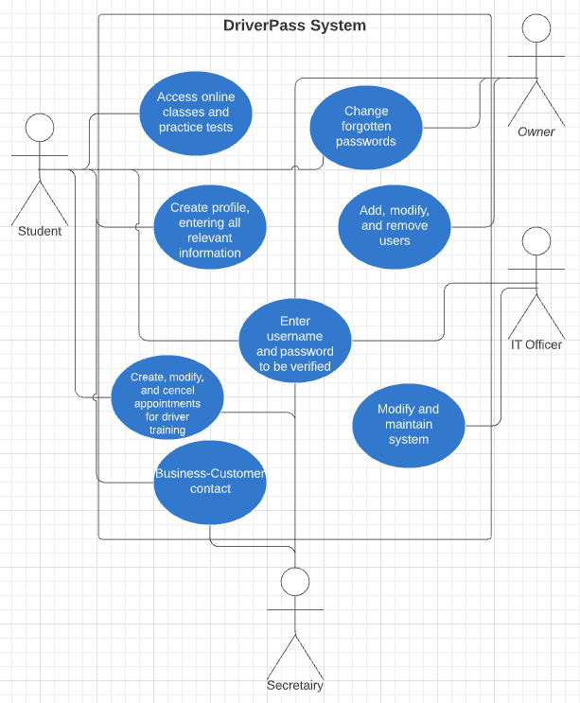
Use Case Diagram
[Insert your use case diagram here.]
Notes:
This UML use case diagram captures many of the interactions that the various actors have with the DriverPass system. The actors on the system are the customers and the company's owner, IT officer, and secretary. Both the secretary and the customers use the system to create a profile, to create/modify/cancel appointments for on-the-road training, and to contact each other. The customers also use the system to access online classes and practice tests and to reset a forgotten password. The IT officer uses the system to perform the maintenance/modifications that DriverPass desires for the system. The owner uses the system to add, modify, and remove users and to reset forgotten passwords. All actors on the system enter their username and password upon logging in for the system to verify.

Slide 4
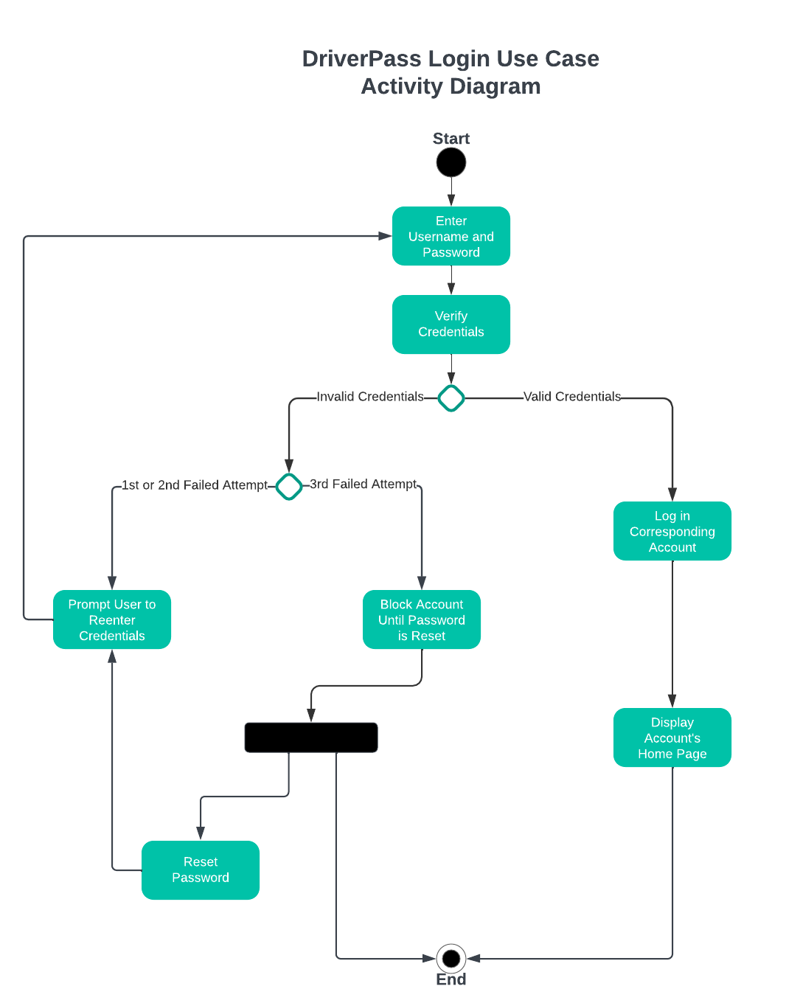
Activity Diagram
Notes:
This activity diagram breaks down the steps taken by the system during a login use case. The process begins with a user entering their username and password, which is then verified by the system. If an account with the login information that was entered exists in the system’s database, that account is logged in and the system navigates to the account’s home page. If there is no account with the entered information in the database, the system checks to see if this is the first, second, or third failed login attempt. If it is the first or second failed attempt, the user is informed that the information was incorrect and they can then reenter the information. After a third failed attempt, the account with the entered username is blocked until its password is reset. From here the user can choose whether or not to reset their password. If they do they are prompted to attempt logging in again after doing so but if not then their use of the system is complete.
This satisfies multiple needs of the DriverPass system. It allows for different kinds of users as each account has unique login information, also providing security as the proper level of access is granted to each user. It also satisfies the need for users to be able to reset their password.

Slide 5
Security
In order to login, users must use their case-sensitive username and password
Customers should be able to reset their password if they forget it
DriverPass Owner will have full control over accounts, including ability to reset passwords and block access
The system will temporarily block user access after three failed login attempts in order to prevent “brute force” hacking attempts
The connection between the client and the server will be secured by the cloud’s built in functionality
Notes:
When considering security for the DriverPass system, the login verification process is very important. The proper level of access is granted depending on what account is logged in. The Owner has specified the need to have control over all accounts so this has been incorporated into the system’s security features. The IT Officer stated that the team wants to focus on running the business with minimal technical problems so the system is designed to run on the cloud, thus taking care of backup and connection security.

Slide 6
System Limitations
Five month time limit for development
Unspecified budget
Requires access to DMV databases
Quality of cloud service depends on budget
Notes:
The time limitation of this system’s design is about five months with requirement collection beginning on January 22nd and the sign-off meeting taking place on May 9th and 10th. No budget for development was specified but the DriverPass team will likely be looking to introduce new features in the future so an effort should be made to keep costs down. A possible technological limitation that could arise is a struggle to access the various databases of the different local DMVs.

